Slide 1
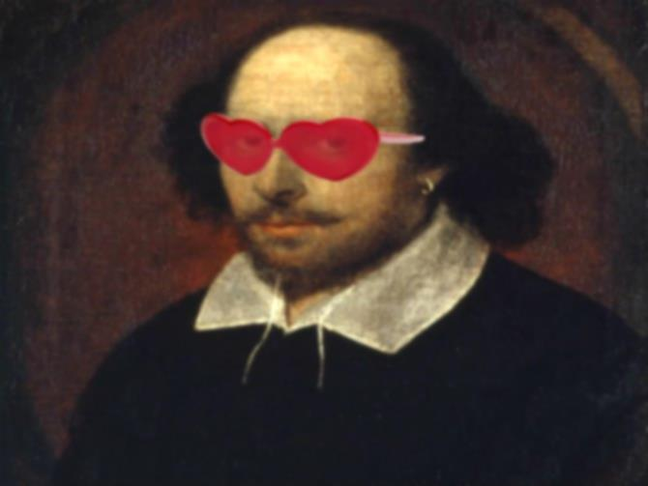
Contexts for Hamlet
The life of William Shakespeare
Elizabethan England
Expectations of royalty
Gender Roles

Slide 2
Elements of Drama
Through actors-
-impact is direct/immediate
-dependent on actor’s skill
-actors can use facial expression, gesture, intonation which can result in more expression than audience’s imagination
-limited to only one point of view: objective/dramatic
*can use a soliloquy or aside to convey thoughts

Slide 3
Elements of Drama cont.
On stage-
-commands attention: the theatre is dark, stage is lighted, no distractions
-confined to the stage- only what can be displayed there- limited complexity, cannot rely on unspoken thoughts and reflections
-limited in scene shifts- may have to stick to one setting for an extended period of time

Slide 4
Elements of Drama cont.
Before an audience-
-experience is communal/public:
affected by others (we laugh when others laugh)
-must hold the audience’s attention:
well defined plot, swift exposition, strong conflict and dramatic confrontations- each act works up to its own climax, interrupted by intermission
-central meaning must be grasped in a single performance:
you can’t go back and read it again,
cannot use long narratives, descriptive passages- relies on spoken interaction

Slide 5
Elements of Drama cont.
The successful playwright combines the power of words, the power of fiction and the power of dramatic technique for a successful play.

Slide 6
Tragedy
Definition of Tragedy: Tragedy is an imitation of an action that is serious, complete, and of a certain magnitude
Tragedy comes in the form of action, not of narrative; with incidents arousing pity and fear

Slide 7
Important concepts of Tragedy:
The tragic protagonist refuses to submit to society's laws and life's rules due to his/her HUBRIS: excessive pride. As a result, there is a conflict in which the protagonist makes an error in judgment caused by his/her hubris: HAMARTIA, which ends the protagonist's life. This tragic end for the protagonist creates a CATHARSIS: a release of emotion for the audience. This is because often the protagonist's death has made things better for the community.

Slide 8
Characters in tragedy
“good or fine.” – through morality or class
“fitness of character” (true to type); e.g. valor is appropriate for a warrior but not for a woman.
“true to life” (realistic)
“consistency” (true to themselves). Once a character's personality and motivations are established, these should continue throughout the play.
“necessary or probable.” Characters must be logically constructed according to “the law of probability or necessity” that governs the actions of the play.
“true to life and yet more beautiful” (idealized, ennobled).

